Slide 1

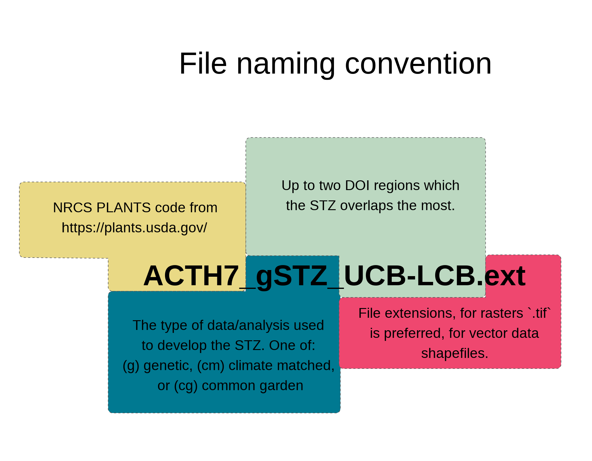
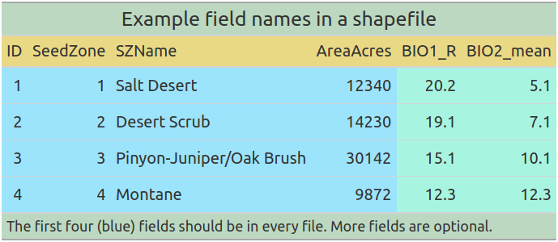
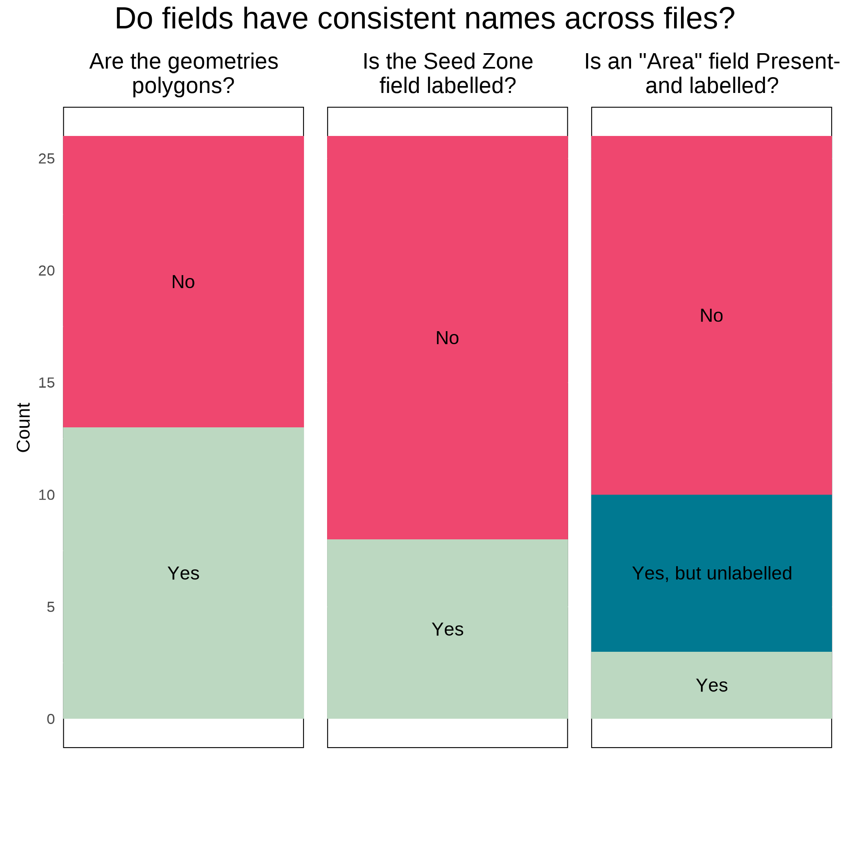
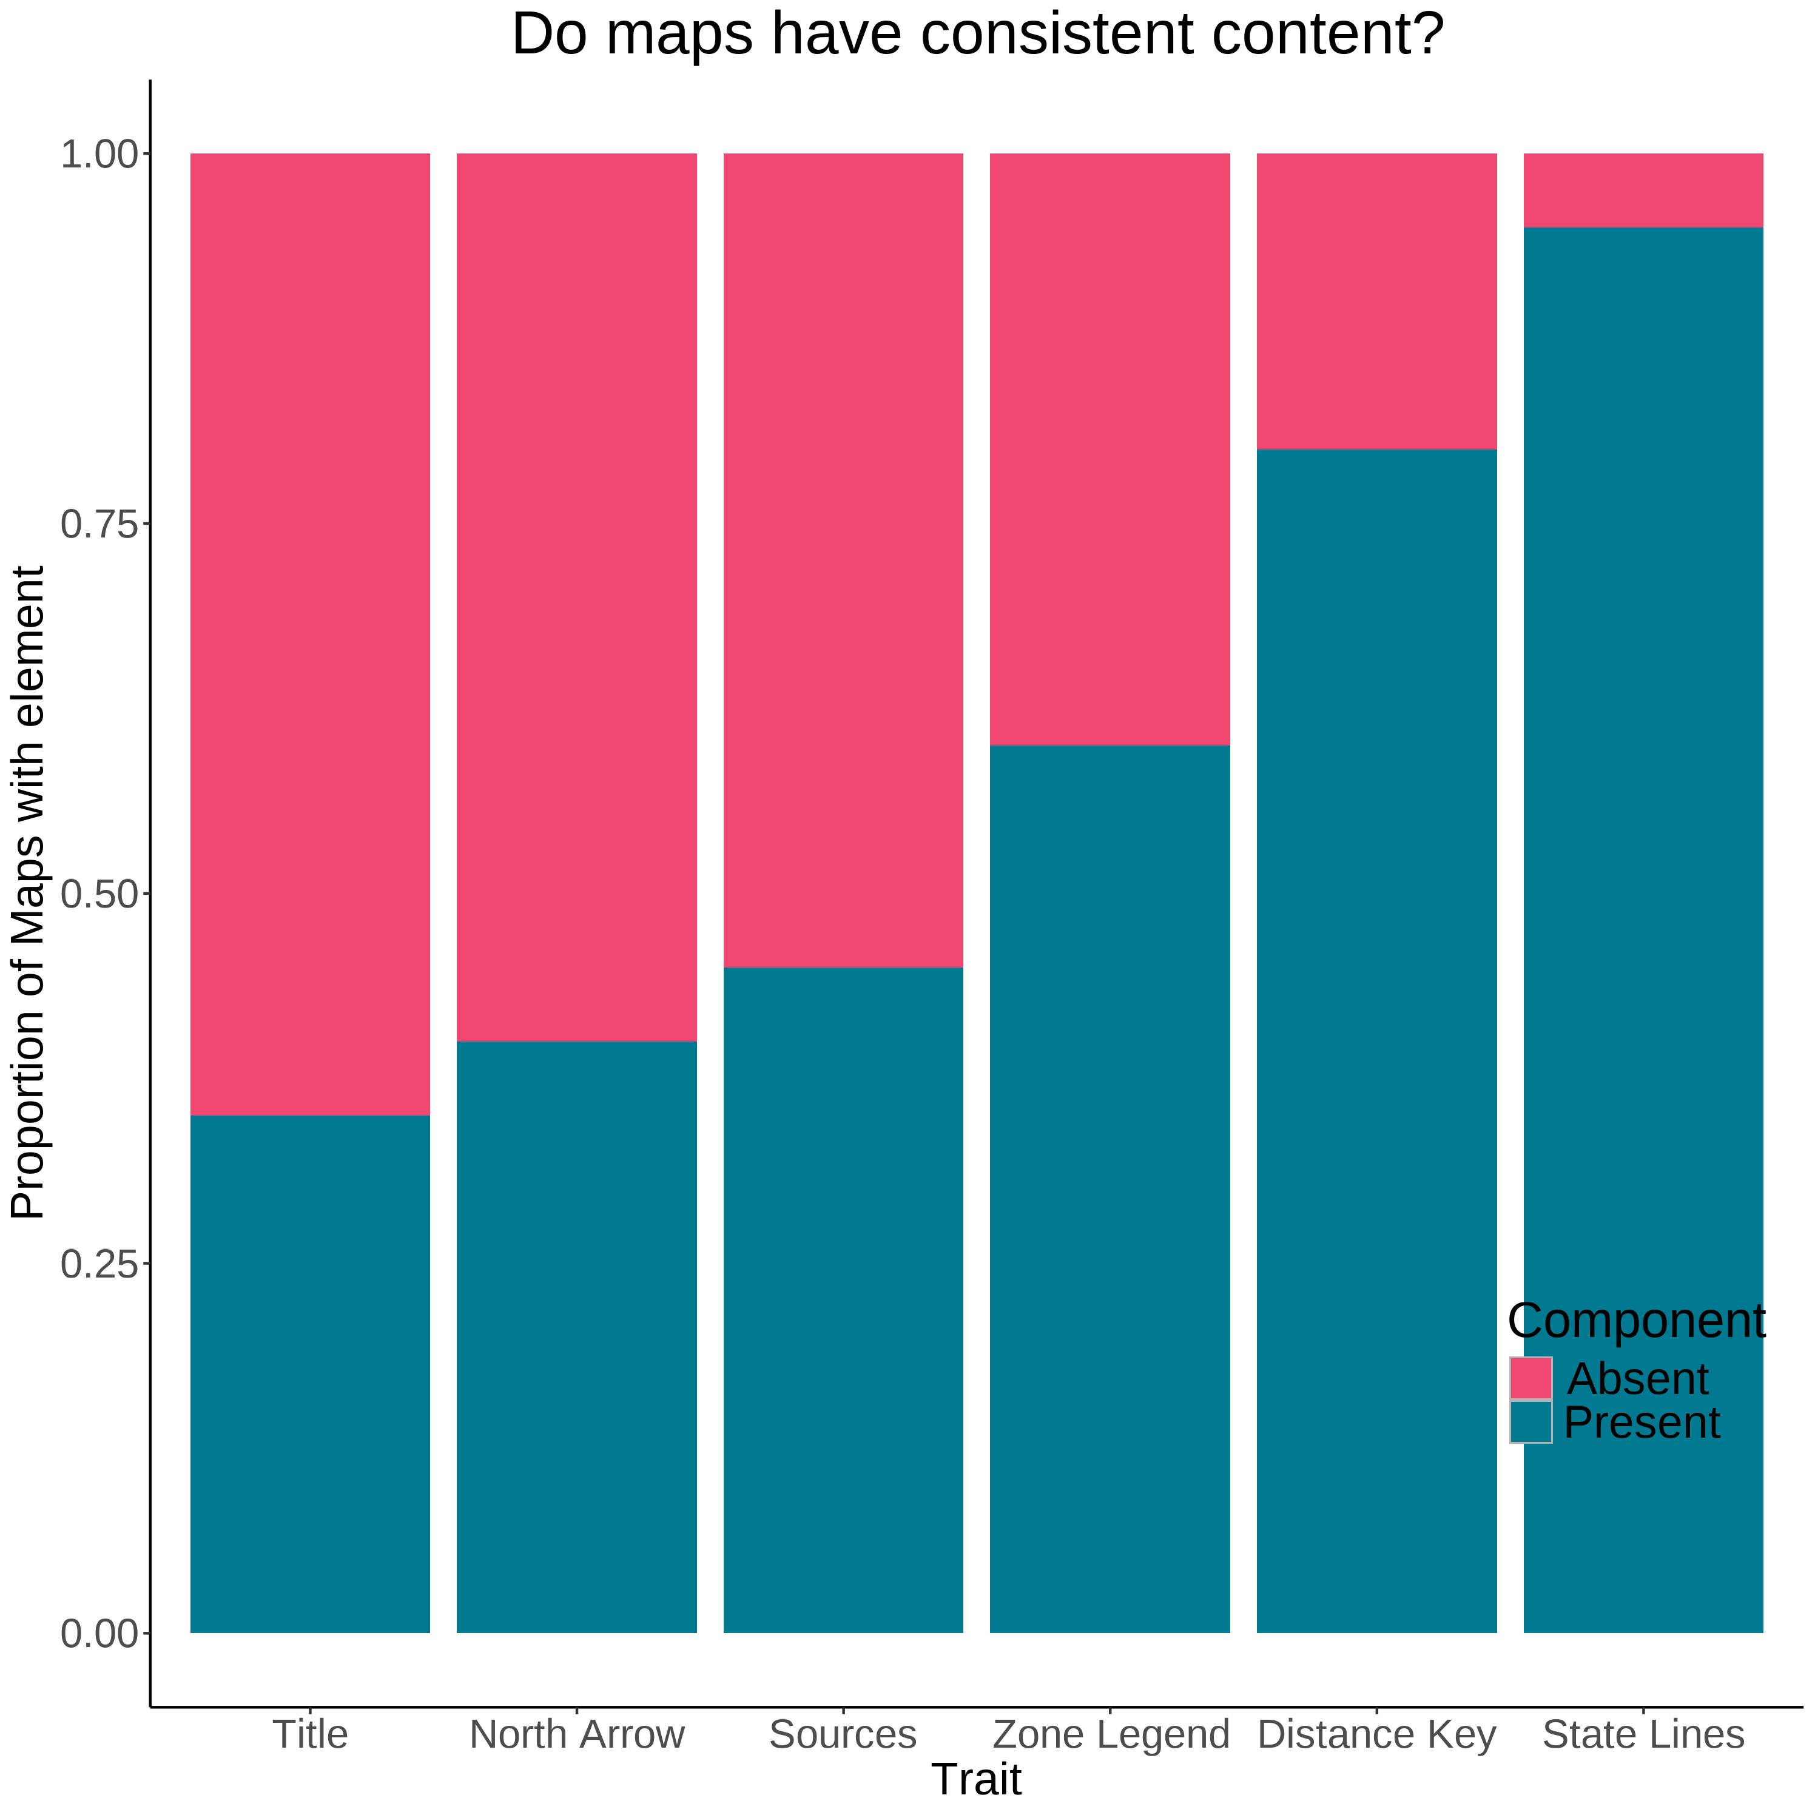
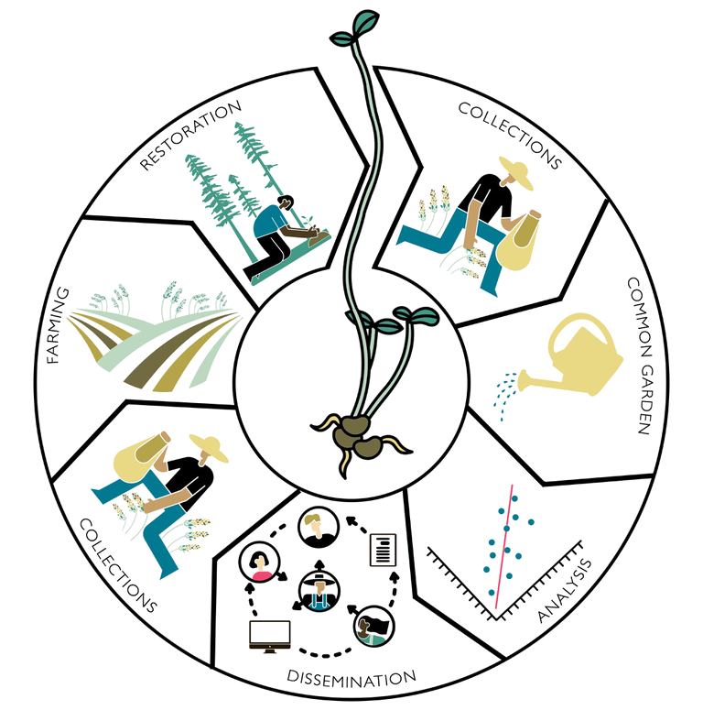
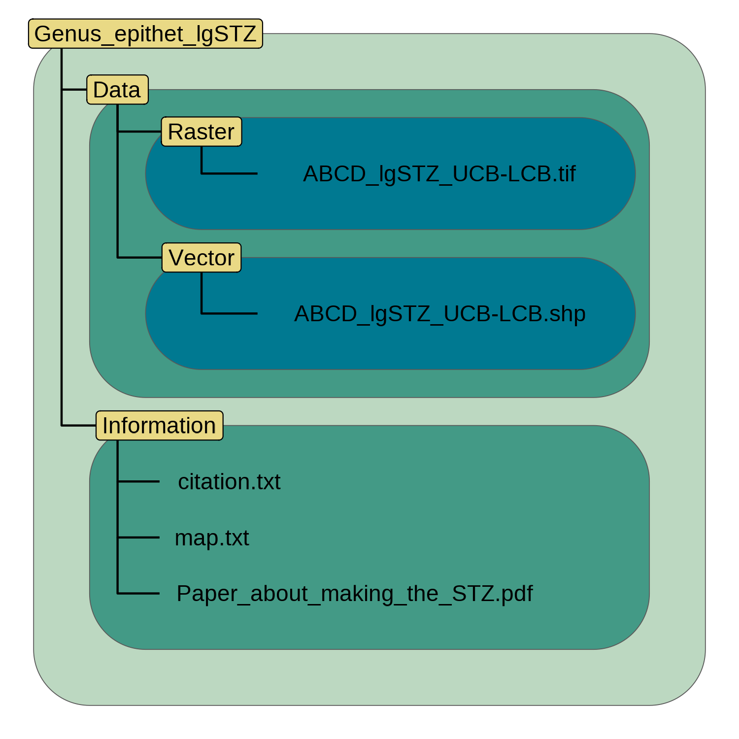
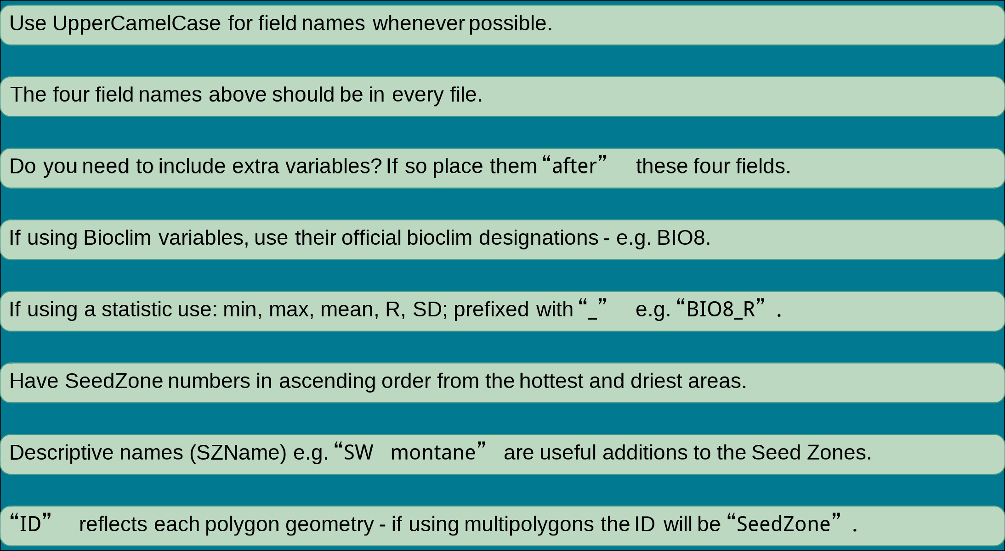

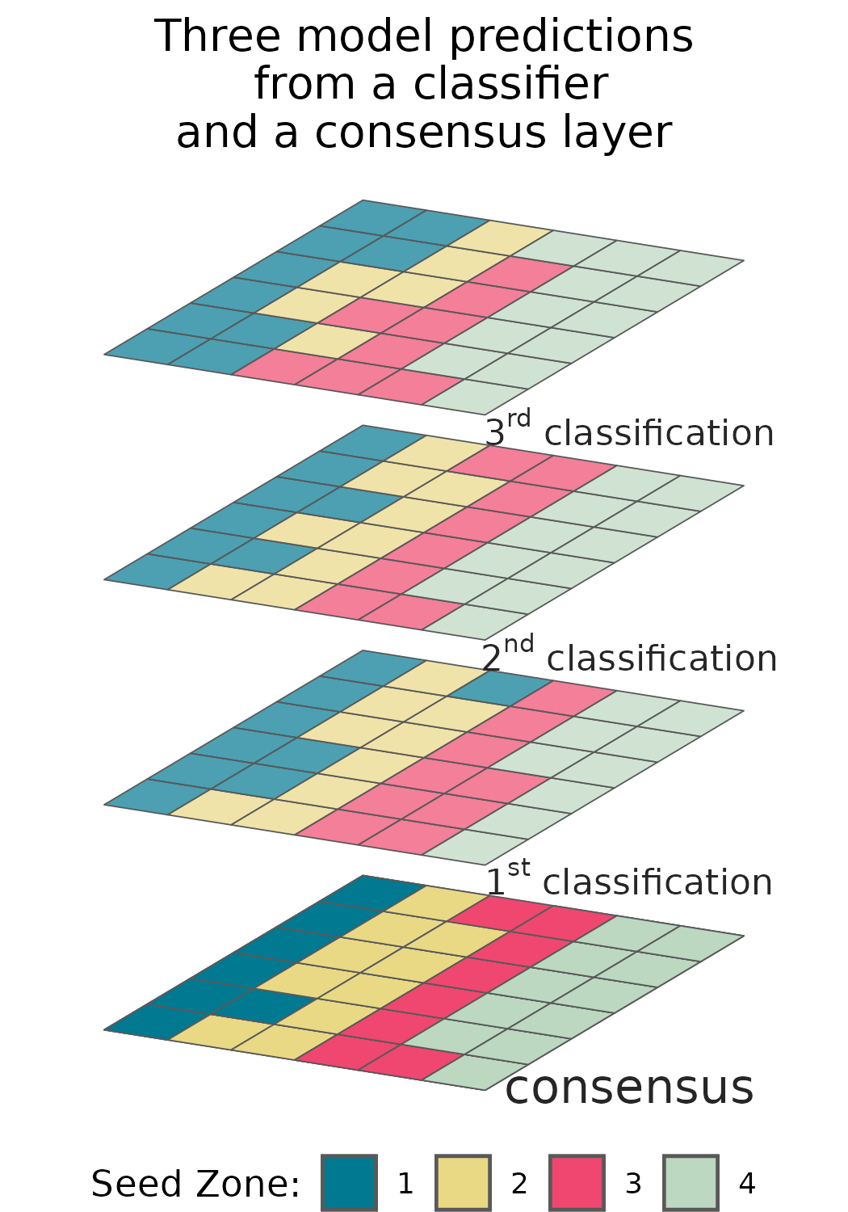
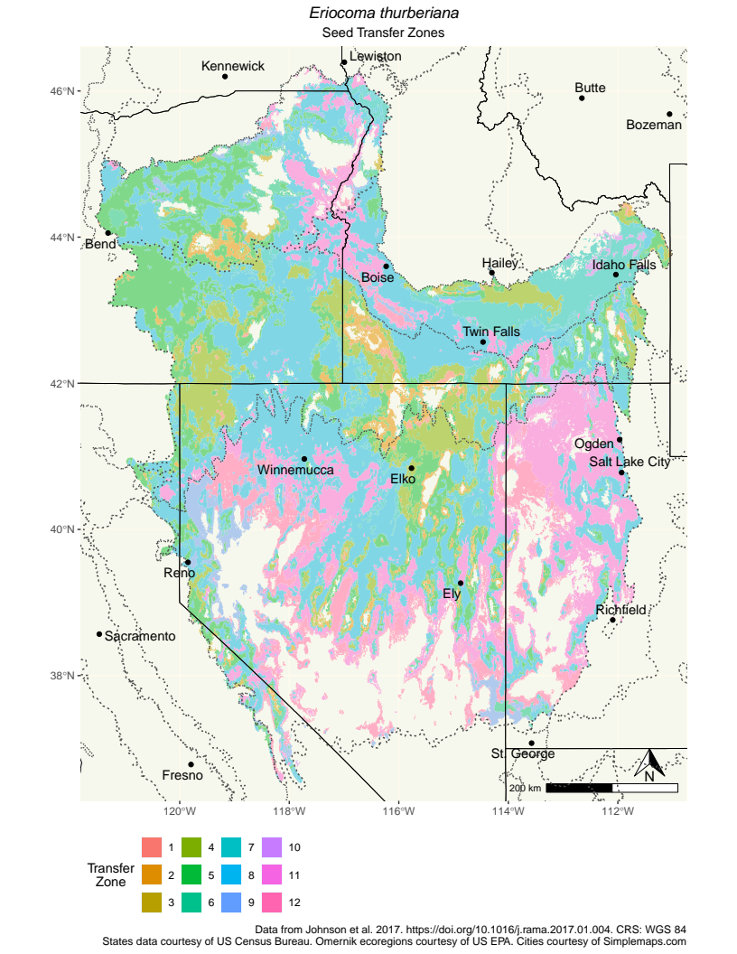
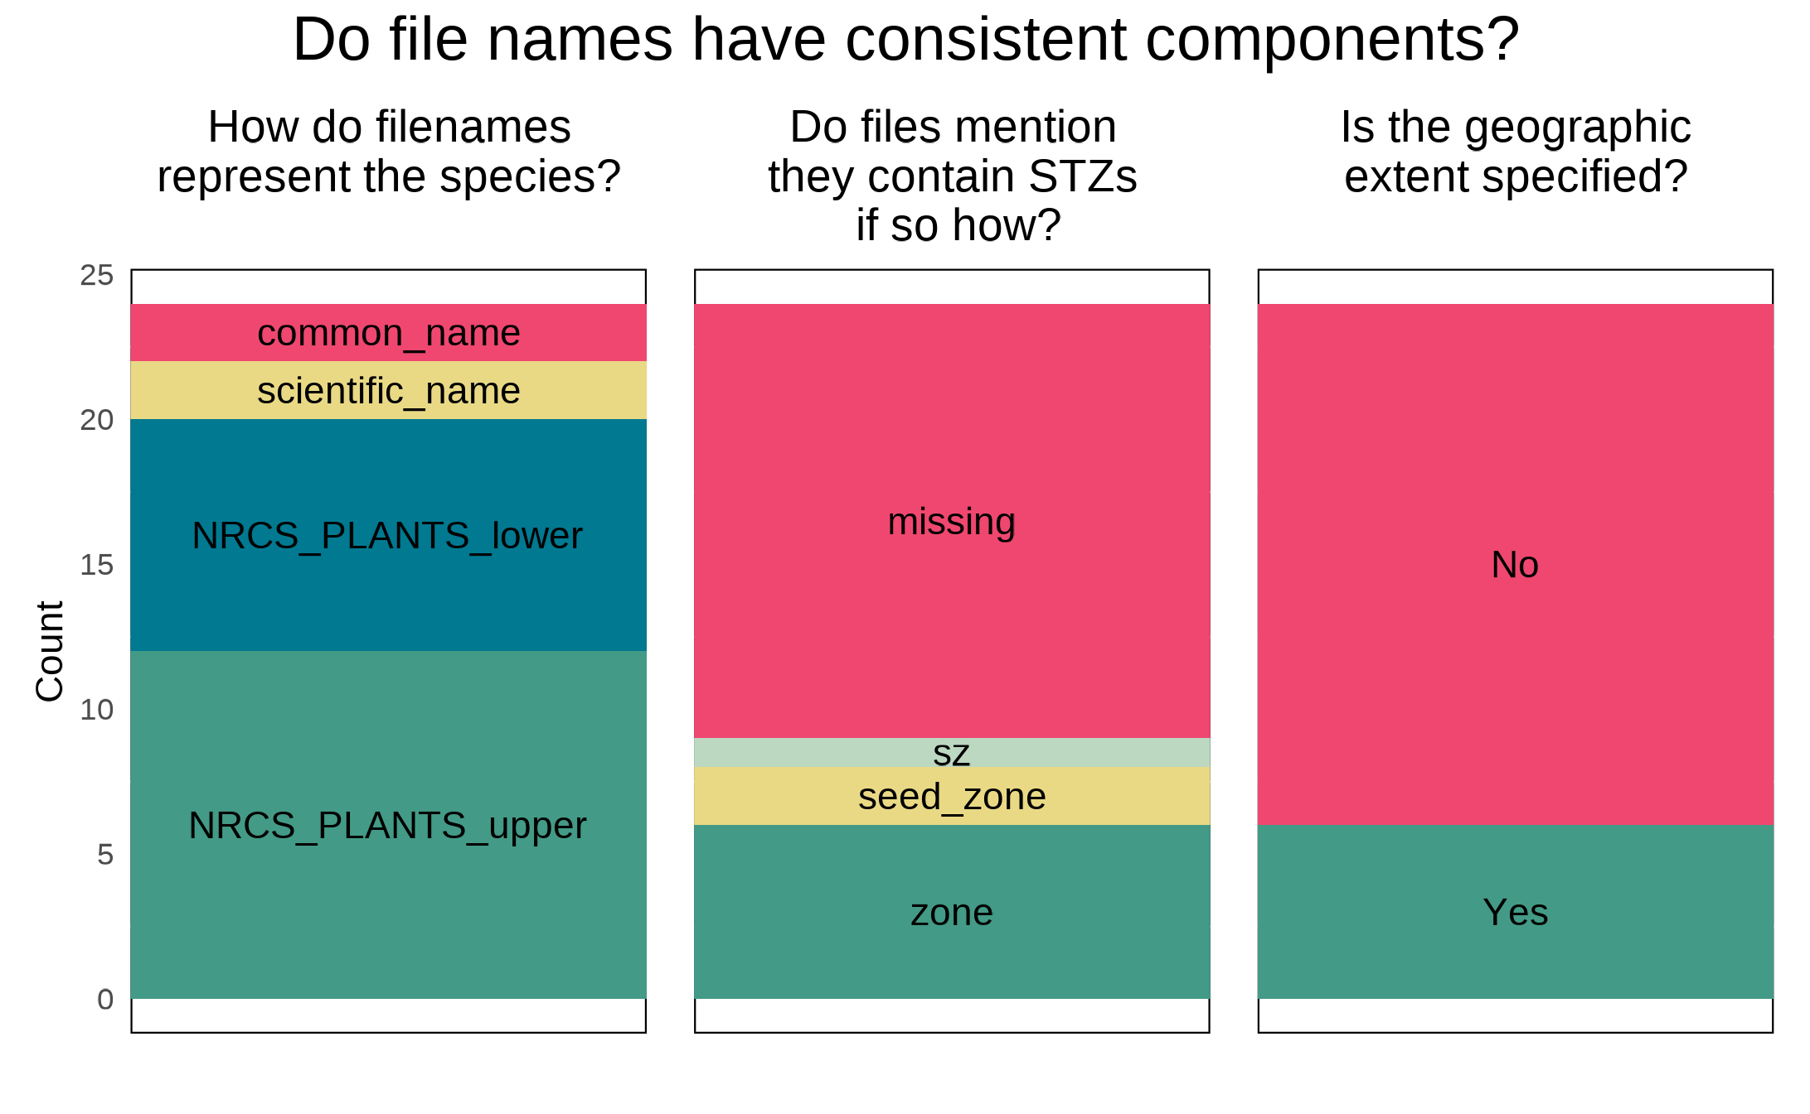
Empirical seed transfer zones require conventions for data sharing to increase their utility
Brianna Wieferich, Reed Benkendorf
E. Woodworth (wu-naut) Brianna.Wieferich@usda.gov
BACKGROUND To increase the availability of locally adapted germplasm, empirical Seed Transfer Zones (eSTZs) are being used to guide restoration and agricultural admixture decisions. eSTZs are based on common garden, genetic, or climate similarity data, and require considerable effort to develop. Despite the rigor with which these studies are conducted, inconsistencies exist in data products derived from them which can hinder their utility and adoption. Here we showcase the inconsistencies in eSTZ data products, offer suggestions for standardization, and report on an R package to implement these suggestions.
Develop:
1) file naming conventions
2) field naming standards in vector data
3) cartographic standards
4) directory structure conventions
5) Implement suggestions in an R package ‘eSTZwritR’
Methods Reviewed all eSTZs on the Western Wildland Environmental Threat Assessment Center (WWETAC) website as of May 1, 2024.
Each data product’s: file name structure, field naming conventions, and directory structure, were analyzed. All scoring was done by hand, and all analyses were carried out in R 4.2.1.
Objectives
Suggestions
Results
Shapefile Properties
- Different polygon types used for treating zones
- Field denoting seed zone was generally lacking
File Names (shapefile)
- Consensus to use USDA NRCS-Plants code
- Many files did not mention the data (seed zones)
- Majority of files lack a specified geographic extent
Map Components
- Several essential cartographic elements (title, statement on data sources, legend for the seed zones) were missing from many products.
These suggestions can be implemented using an R package, ‘eSTZwritR’. Or by consulting it’s webpage. We look forward to collaboratively developing standards in the future!
Conclusions Myriad discrepancies exist in the way that eSTZs are being distributed. Here we present standards for the scientists developing eSTZs to use in order to standardize the data products they develop. We provide an R package to implement our suggestions.

